Slide 1

MBE 713: Marine Population Dynamics
Elizabeth A. Babcock

Slide 2

My background
Fisheries Science, quantitative ecology, Bayesian statistics, bycatch
Mostly fisheries work, including fisheries stock assessments
Sharks
Finfish, conch, spiny lobster
Protected species
sea turtles, marine mammals
Extinction risk and endangered status
IUCN, CITES, ESA

Slide 3
Today
Brief intro on population dynamics, what it is and what it is used for
Mathematical models
Course syllabus
GitHub for sharing code

Slide 4
Population Dynamics
Tracking trends in abundance of a marine animal over time
Surveys
Data from fisheries
Mark-recapture studies
Modeling change in abundance over time
Estimate fecundity and survival
Use estimates to predict change in abundance over time

Slide 5
Why population dynamics?
For fisheries and other living marine resources
Evaluate status relative to reference points
Estimate likely effectiveness of conservation and management strategies
For protected species
Managing incidental take and allowable catch or bycatch limits in fisheries
Estimating extinction risk, e.g. IUCN Red List, CITES, ESA

Slide 6
Fishery stock assessment
Combine data on catches, abundance trend data, biological data, etc. with a population dynamics model to
estimate current status with respect to reference points.
Predict the effect of proposed management actions
www.iccat.int/documents/scrs/other/glossary.pdf

Slide 7
Reference points (ICCAT)
“Target reference point: A benchmark that should be achieved on average according to a given set of management objectives. ICCAT´s implied targets are F_{MSY}, B_{MSY} and MSY*
Limit reference point: A benchmark that should not be exceeded with any significant probability according to a given set of management objectives”
*MSY is maximum sustainable yield, F is fishing mortality, B is biomass
www.iccat.int/documents/scrs/other/glossary.pdf

Slide 8
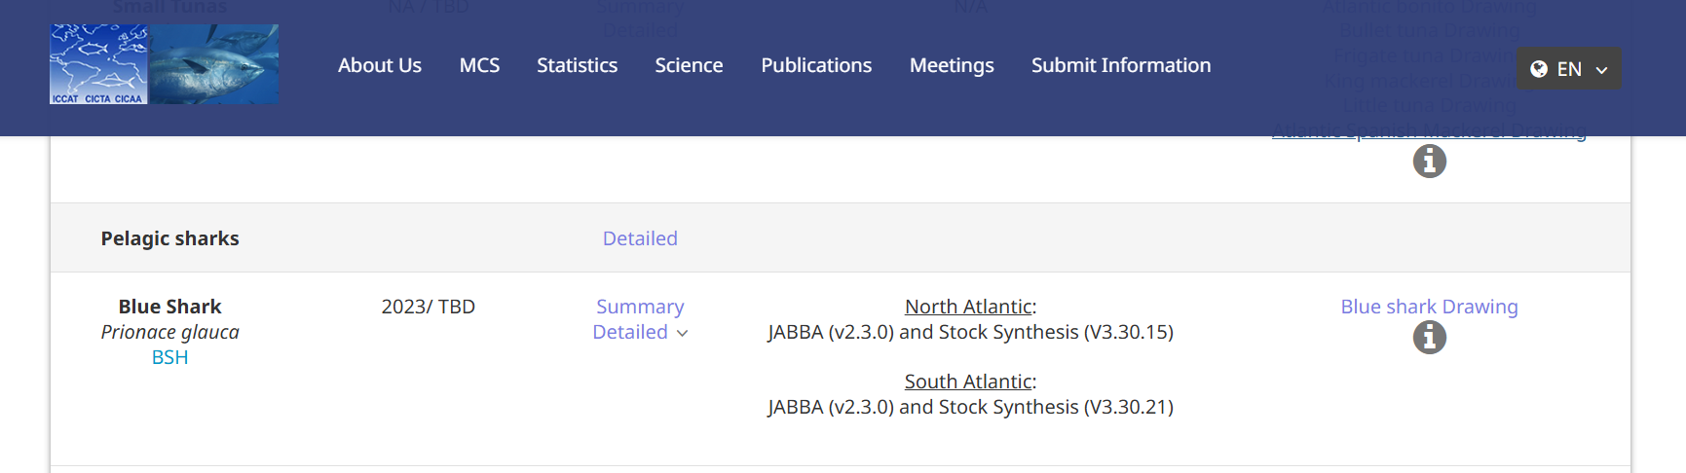

ICCAT: International Commission for the Conservation of Atlantic Tuna
https://www.iccat.int/en/assess.html

Slide 9
Data for N Atlantic blue shark
Abundance trends from fishery data
Also have biological information
Age at maturity
Length at age
Number of pups
Interpupping interval
Natural mortality rate
Catches (red is N Atlantic)
www.iccat.int

Slide 10
Assessment of status
Stock assessment combined data with population dynamics models (JABBA and StockSynthesis) to estimate status with respect to target reference point of MSY
Line at 1.0 is Bmsy, the biomass to stay above, or Fmsy, the fishing mortality rate to stay below.
www.iccat.int

Slide 11
Projections
Managers use this information to decide on a quota, with an acceptable probability of maintain the population above the reference point
www.iccat.int

Slide 12

IUCN estimates of extinction risk
https://www.iucnredlist.org/

Slide 13
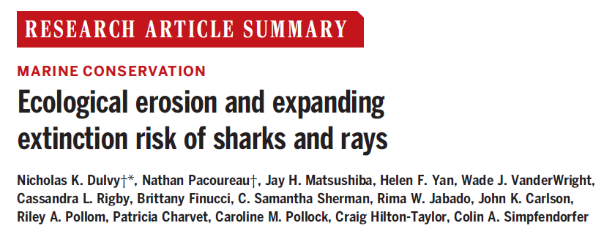
Example: Shark extinction risk
Dulvy et al. 2024

Slide 14
Shark and ray population decline
Dulvy et al. 2024

Slide 15
Estimating extinction risk
IUCN (World Conservation Union) red list ranks species on their relative risk of extinction
Criteria are a checklist of characteristics that are typical of species at risk of extinction. A species is at risk if any of them are met

Slide 16

RedList_Cats document
https://iucn.org/sites/default/files/import/downloads/redlistcatsenglish.pdf

Slide 17
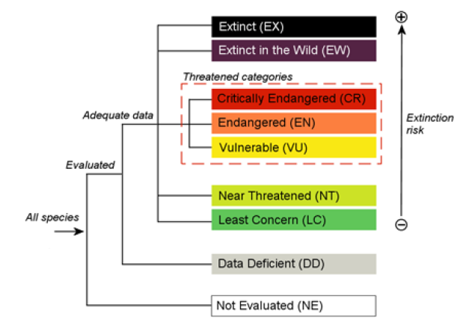
Red list risk categories
IUCN Red List Categories and Criteria Version 3.1

Slide 18
Index averaging IUCN status across species
Sharks’ IUCN status is declining rapidly
IUCN status usually is not calculated by population dynamics models.
It is based on a semi-quantitative checklist of status criteria related to population dynamics
Models may be used if available.
Models are also used for projecting possible future changes in IUCN status
Individual species status
Dulvy et al. 2024

Slide 19
Critically endangered meets any of criteria A-E
Reduction in population size (mature individuals only):
>90% over the last 10 years or 3 generations, where the causes are understood and have ceased,
based on:
direct observation.
index of abundance.
occupancy or habitat.
levels of exploitation.
introduced species, pathogens, etc.
2. >80% where the causes are not known or controlled (a-e)
3. >80% decline predicted for next 10 years or 3 MGT
4. >80% decline for time period including past and future

Slide 20
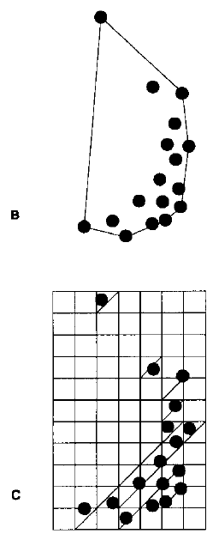
Critically endangered meets any of criteria A-E
occurrence
B. Reduction in geographic range
Area of occurrence less than 100 km² and
a. fragmented or at 1 location
b. declining in:
1. occurrence. 2. occupancy. etc.
c. fluctuating in:
1. occurrence. 2. occupancy. etc
Area of occupancy less than 10 km² and
a. fragmented or at 1 location
b. declining
c. fluctuating
occupancy

Slide 21
Critically endangered, continued
C. Population size estimated to number fewer than 250 mature individuals and either:
1. continuing decline > 25% within 3 years or 1 generation
2. continuing decline and
a. subpopulation structure (1,2)
b. extreme fluctuations
D. Population size less than 50 mature individuals
E. Quantitative analysis showing the probability of extinction in the wild is at least 50% within 10 years or three generations

Slide 22
Endangered and Vulnerable have similar criteria with different cut-offs
*
VU: D. 1. Population below 1000, 2. Population with a restricted area of occupancy

Slide 23
Data needs for extinction risk assessment
Historical data on trends in abundance from
Surveys
Catch per unit effort (CPUE)
Catch
Citizen science or local knowledge
Population dynamics models if available
Predict future population trends, and directly estimate extinction risk
Needs data to estimate biological traits, like fecundity, mortality, as well as data on threats

Slide 24
Modeling population dynamics
Extinction risk estimation
What is the probability of extinction in the next 20 years if current threats continue?
Fishery management
Estimate reference points: is population over- fished?
Both: Predict whether a management/conservation action or threat will cause increase or decrease of population

Slide 25
Basic concepts of modeling Simple population models
Characteristics of mathematical models
Model structure
Parameters and variables
Model fitting
Model assumptions

Slide 26
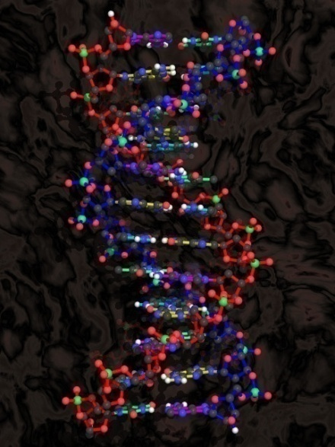
Modeling concepts
Mathematical models are a subset of models (physical, diagrammatic, conceptual)
All models are an abstraction (simpler) representation of the phenomenon or process being characterized
Need to select the properties of the system for the model to be replicate
All models have limitations derived from how (type, purpose, assumptions) they were designed

Slide 27
Mathematical Model components
Variables are entities that can be defined and associated with observations from nature
Parameters are quantities that help define the relationships between variables
Operators are mathematical functions that establish the relationship between variables and parameters

Slide 28
Types of Model structure
Static (equilibrium) vs dynamic
Deterministic vs stochastic
Continuous vs discrete
Descriptive vs explanatory

Slide 29
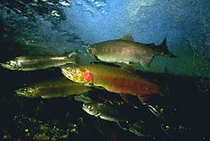
Hypotheses and Model development
Real system
Observation
Variables
Hypotheses
Mathematical model
Scientific enquiry,
and theory

Slide 30
Model assumptions
All assumptions should be explicit and should be listed when a model is presented.
The implications (shortcomings, benefits) of making the assumptions should be stated

Slide 31
Working with models
Estimation: Fit the model to data to estimate parameters, e.g. using maximum likelihood
Maximum likelihood, etc.
Prediction: Predict the values of variables in data that has not been sampled yet.
To evaluate model prediction skill
Forecasting: Predict values of variables in the future
Fishery projections, climate forecasts
Simulation: Use the model to generate simulated data
To understand the effects of parameters and model
To test if estimation model works.

Slide 32
MBE 713: What you will learn
The basics of modeling population dynamics, e.g.
Logistic (surplus production) models
Leslie matrix models
Statistical catch at age models
Extinction risk estimation models (Vortex)
Food web models (EcoPath/EcoSim)

Slide 33
What you will learn
Statistical models to estimate abundance trends over time
Surveys
Catch rates in fisheries (CPUE)
Mark/recapture
Statistical models to estimate basic life processes
Mortality/Survival
Growth
Fecundity

Slide 34
What you will learn
How models are used to inform conservation, management for endangered species, protected species and harvested species

Slide 35
What you will not learn
Population genetics models, evolutionary models
Physiological models

Slide 36
Skills you will acquire
R programming
How to work in a team
How to use R libraries, GitHub and other tools
Simulating data
Estimating linear and non-linear models
Model selection
Diagnostics and model evaluation

Slide 37
If you don’t know R or GitHub
We will start simple, so you will be able to learn as we go
For Thursday’s class, do the R and tutorial on the Canvas site. We will go through this and build from on it in class

Slide 38
Class format
Each class session we will:
Review assignment from the last class (due before class).
Submit quiz or in-class activity.
Have brief lecture for the new material
Work through an R demo together.
Begin the assignment to be due next time.
Lecture and demo will be recorded on Zoom.
Please log in to Zoom (muted) so we can share screens.

Slide 39
Syllabus
Syllabus is on Canvas
See glossary for fisheries terms

